Slide 2






Agenda
What it is
Prices
Who we are
Website
Conclusion

Slide 3

What is it
Keys is a portable storage that you can wear on your wrist in a really fashionable way!

Slide 4
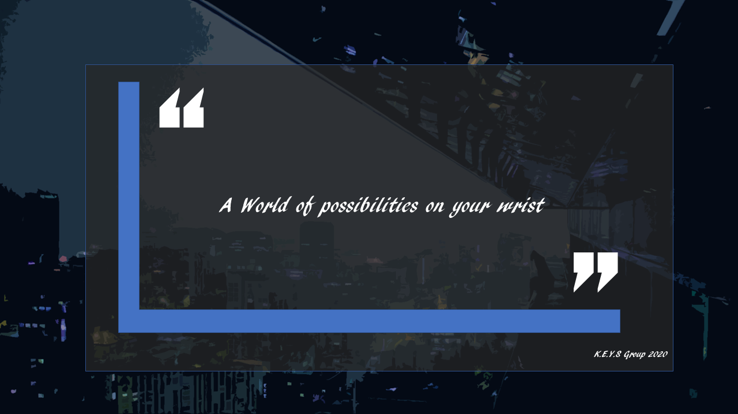

Slide 5
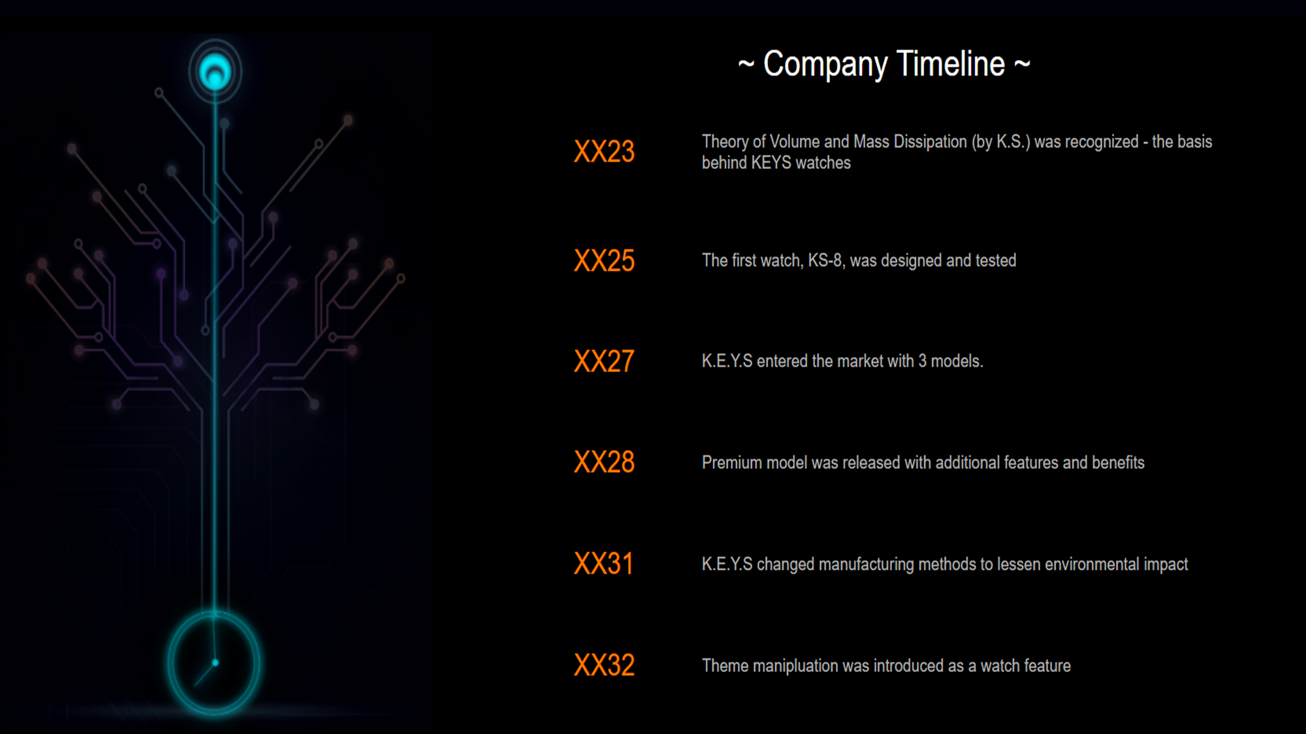

Slide 6

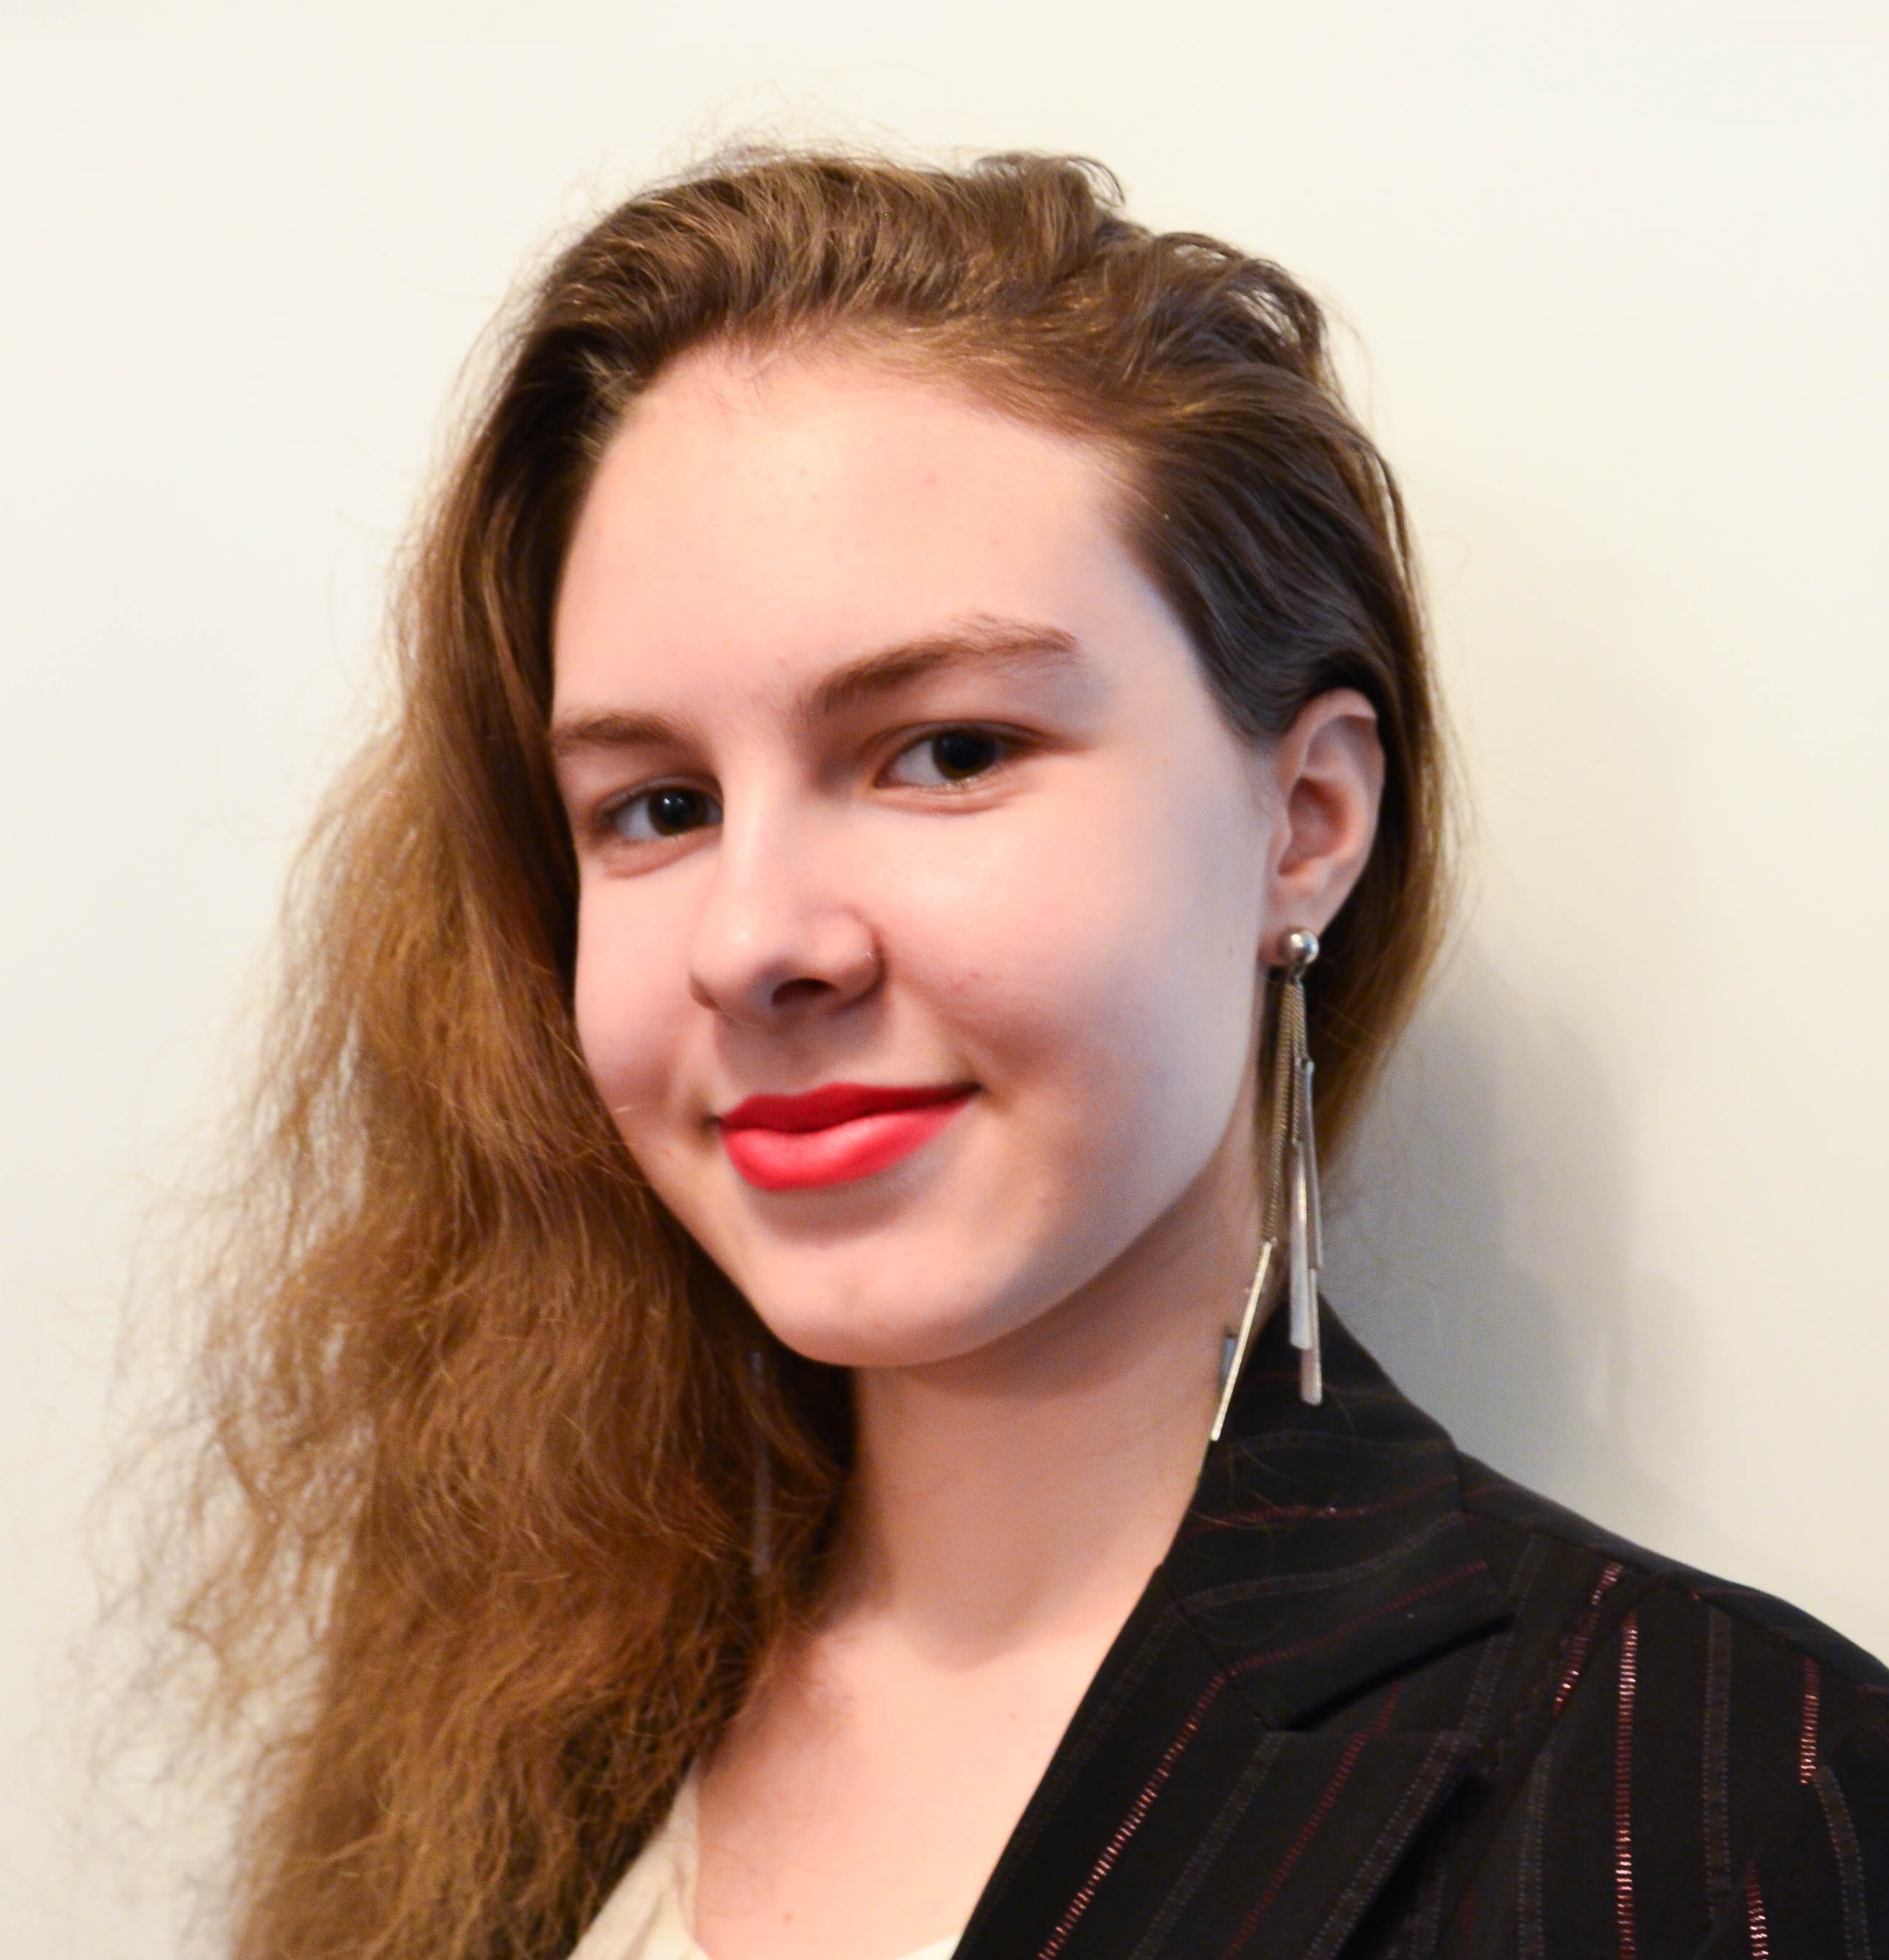

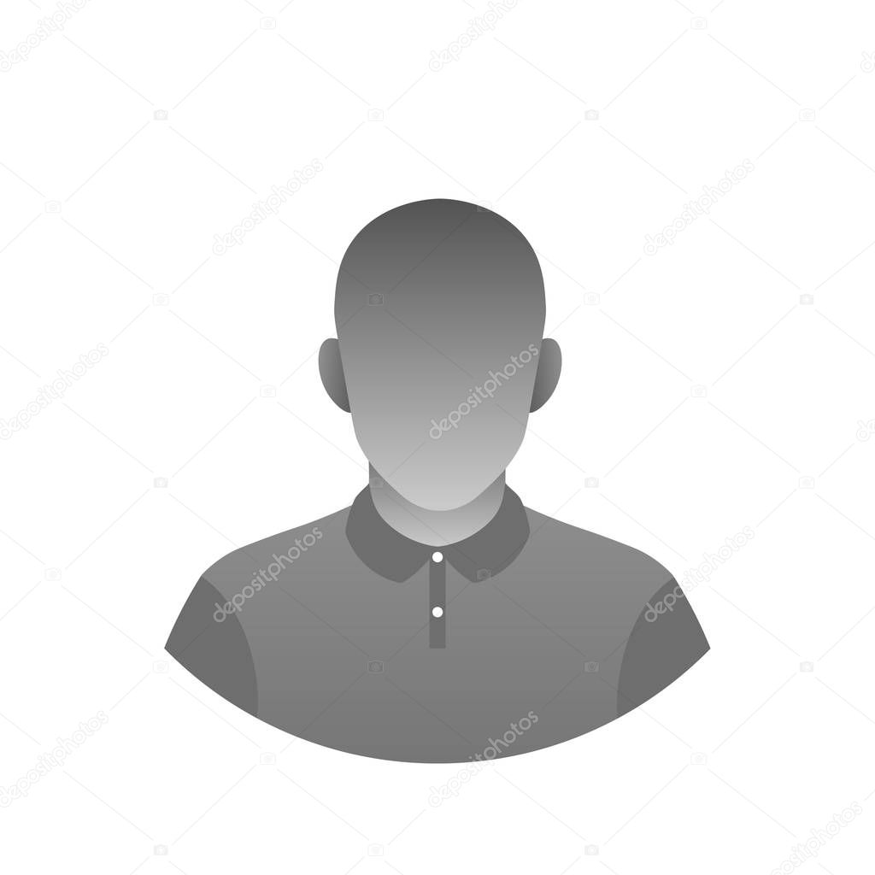
Svetlana Esina
Design specialist
Meet The Team
Daniel Andreev
Role
Jacob Pilon
Role

Slide 7


Jayden Bergevin
Design specialist
Meet The Team
Jean-Gabriel de Montigny
Role
Maryan Khalil
Financial Director

